Slide 1
Happier Together… in the workplace

Slide 2
Communication
Compassion
Connection
Children
Schools
Families
Community
Workplace
Notes:
Social & emotional learning to pre-schoolers through 8th grade and their teachers
Assist schools in improving school culture
Partner with schools for family nights and parent education
Help coordinate culturally responsive community events to better understand racism and bridge the gap between cultures
Provide workshops on communication and conflict resolution

Slide 3
Communication
Happiness
Mindfulness
Gratitude
Notes:
Today I want to share some tools I’ve had the good fortune to learn over the last few years that have shifted my understanding and helped me live a happier and more fulfilling life… both personally and in the workplace. Everyone who works at Peacemaker says “I feel so lucky… I have learned so much by working here about things that would have helped me earlier in life.” Many of the things I will talk about, we teach to children, but we use every day in our workplace and we have a workplace that people truly enjoy being a part of.

Slide 4
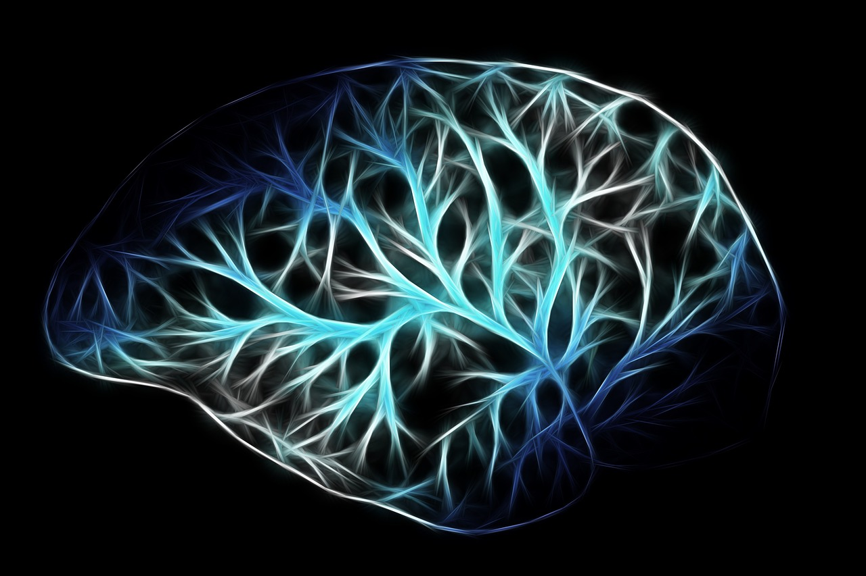
Notes:
Exciting time to be in this line of work. Every day there is new information about how the brain works that helps everyone from preschoolers to adults understand better ways to navigate in the world.

Slide 5
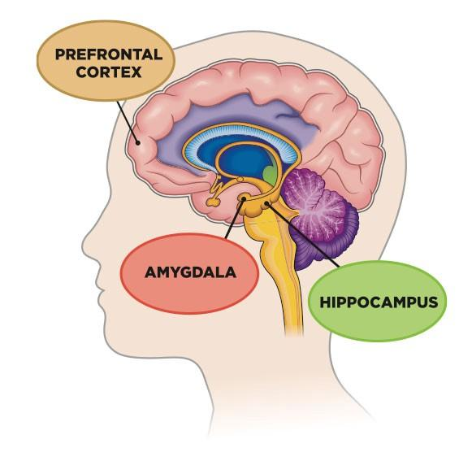
Notes:
Yes. Our staff teach Preschoolers the words amygdala and prefrontal cortex and they get it.

Slide 6
Wise Owl
Guard Dog
Notes:
We talk to them about how the amygdala helps us stay safe like a guard dog -- fight flight or freeze response Prefrontal cortex is our wise owl – it affects things like holding conversations, reasoning, self-monitoring and time management.
Stress and drama in the brain fires up the amygdala, which gets the prefrontal cortex off its game

Slide 7
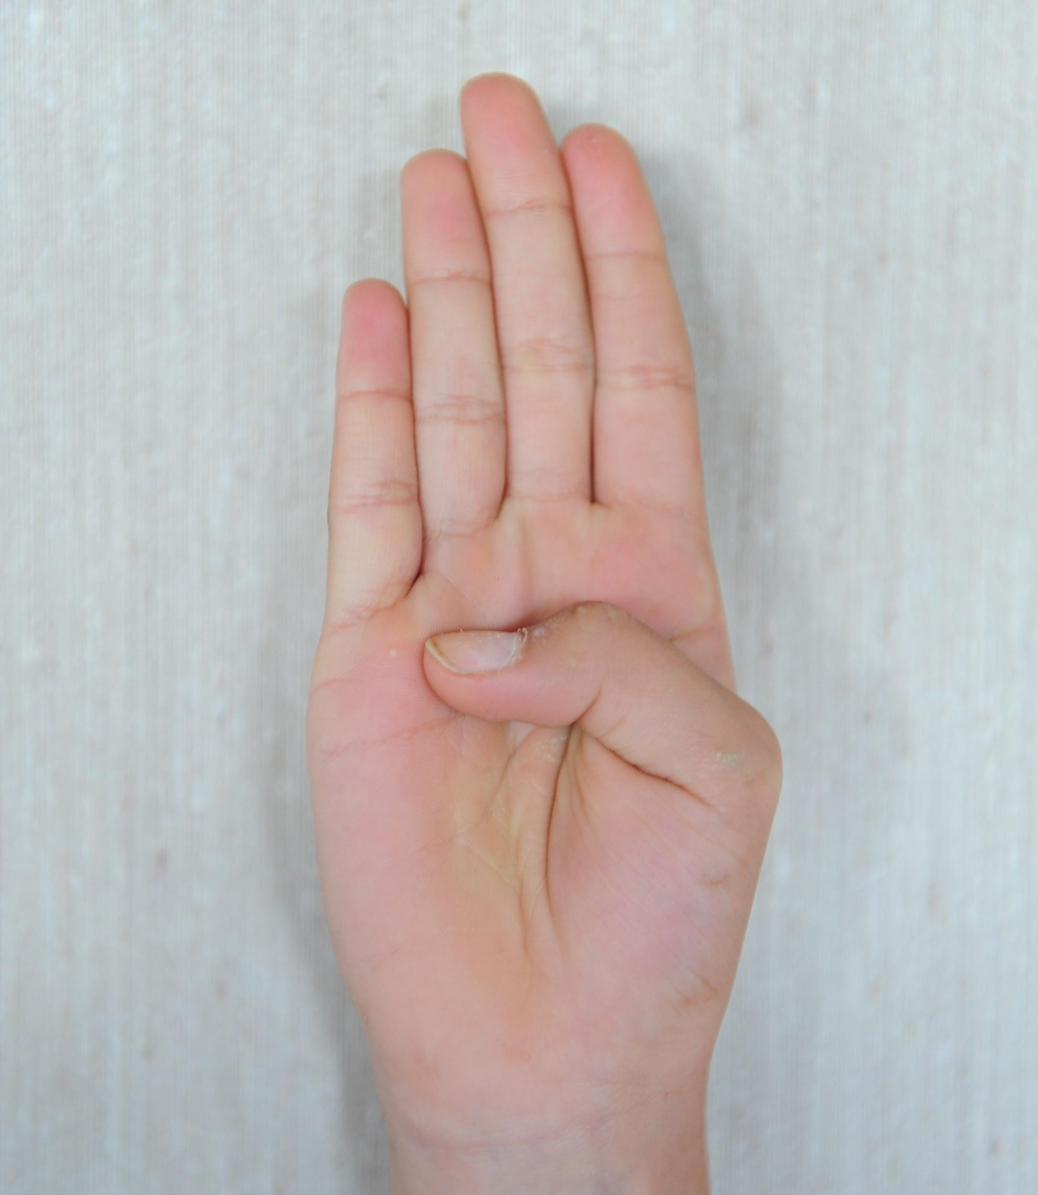
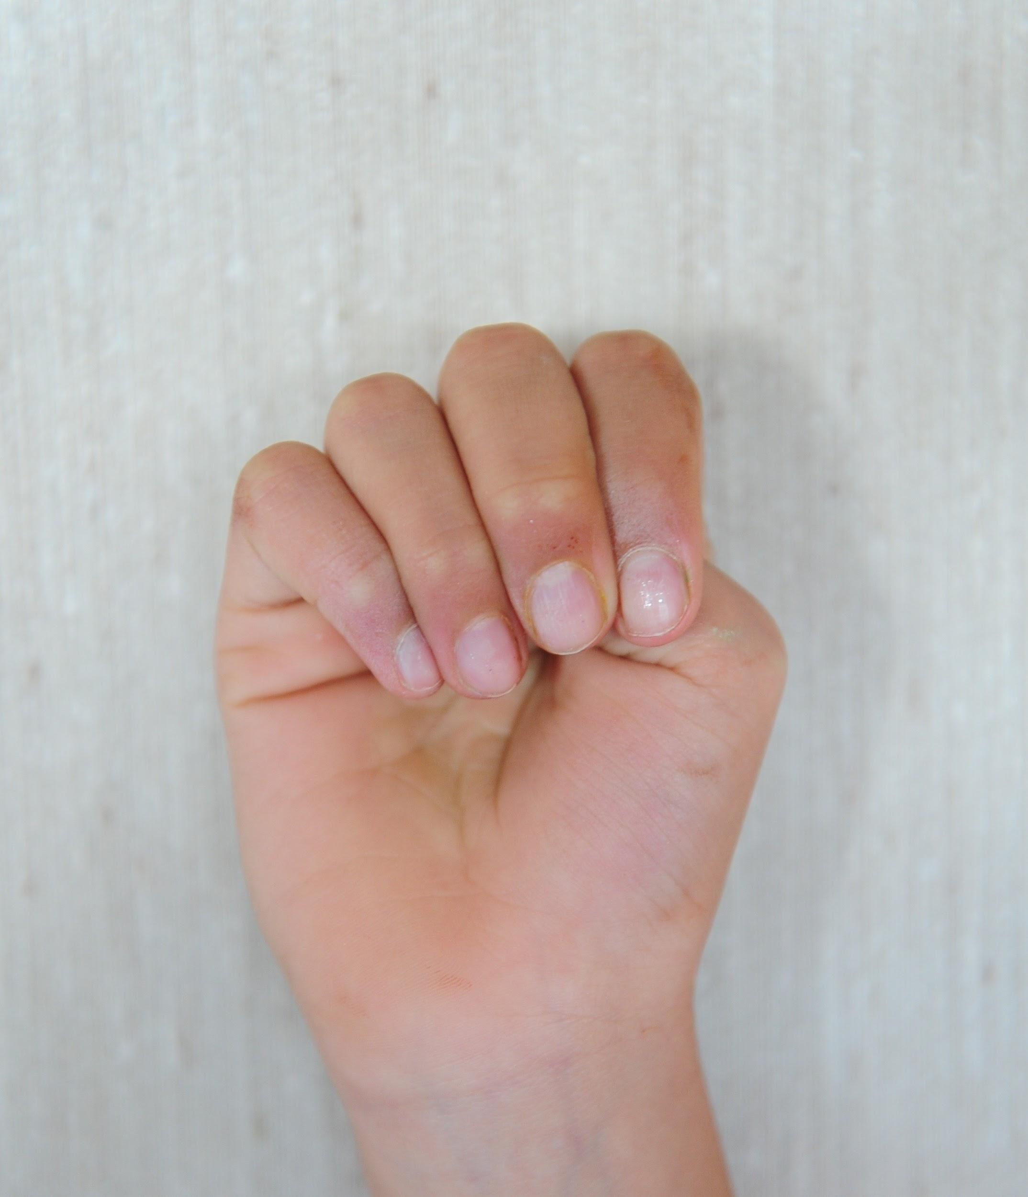
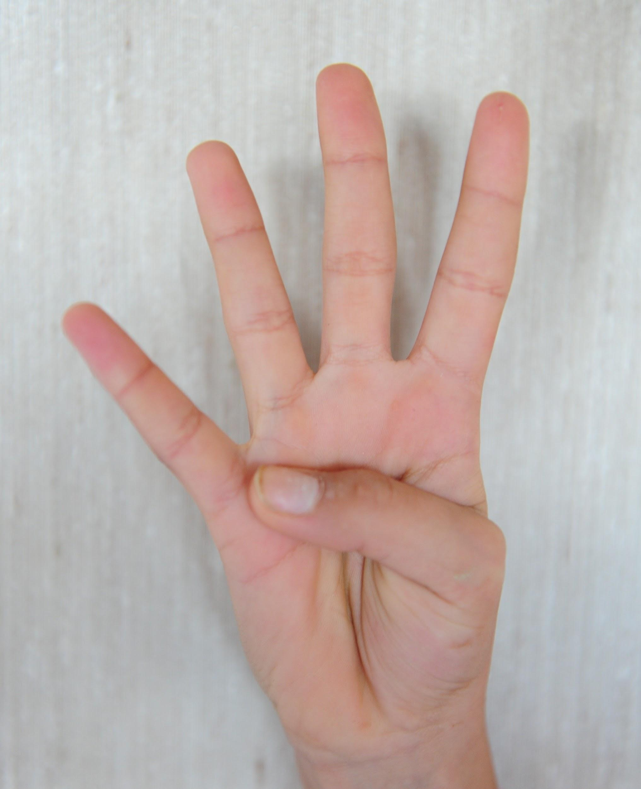
Amygdala
“Guard Dog”
Prefrontal Cortex
“Wise Owl”
Flip your lid!
Adapted from Dr. Dan Siegel’s Work
Notes:
If you have kids or are working with kids you can encourage them to be brain scientists and teach people how stress impacts the brain using this brain hand model. We have many stories of kindergartners teaching their parents about this. This is the amygdala. It keeps us safe. This is the prefrontal cortex… it helps us think. When we are super stressed, we FLIP OUR LID and our amygdala is active but our wise owl has flown away.

Slide 8
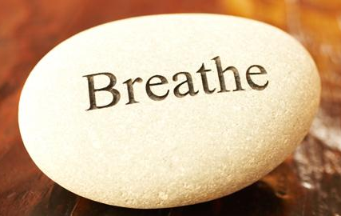
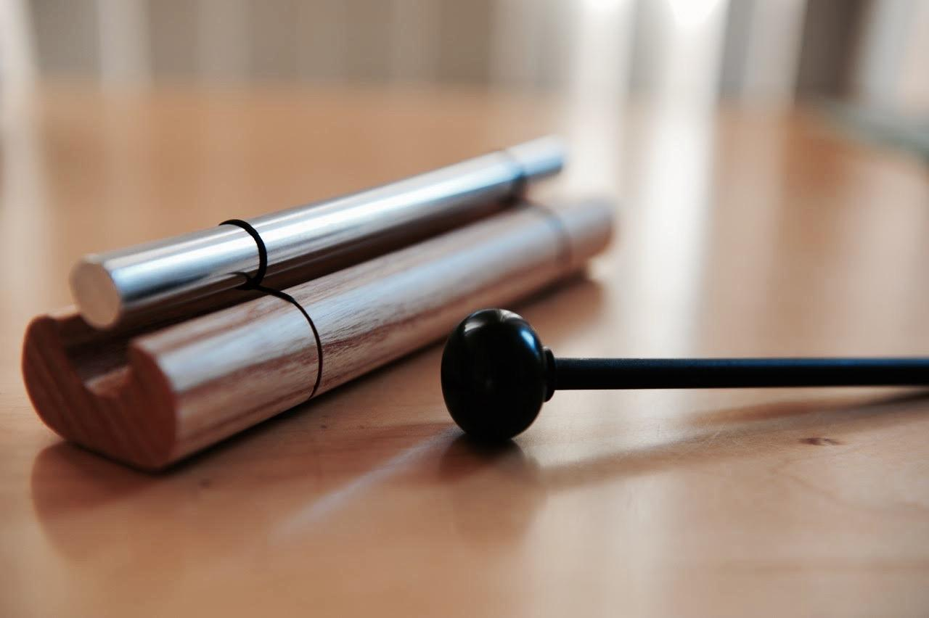
Notes:
What can help us not flip our lids.. Or to return to a calm brain after we have? Simply taking deep breaths is helpful and for even deeper and better results, mindfulness practices can keep us in our calmer, thinking brain more often.

Slide 9
What is Mindfulness?
Paying attention on purpose with an attitude of kindness
to ourselves and others.
Notes:
Mindfulness is the practice of paying attention — to thoughts, physical sensations, and the environment — without constantly feeling the need to judge what’s happening or to make it other than it is.

Slide 10
What mindfulness is not
Relaxation
Religious
Thinking of nothing
Notes:
Although I feel more relaxed after practicing mindfulness, the intent is to exercise the connections in our brains that allow us to be in a state of not constantly judging or rehashing past or future events.
Although many religions, including Buddhism, Hinduism and Christianity -- have used contemplative practices as a spiritual practice, mindfulness in the workplace and in schools is not a religious practice.

Slide 11
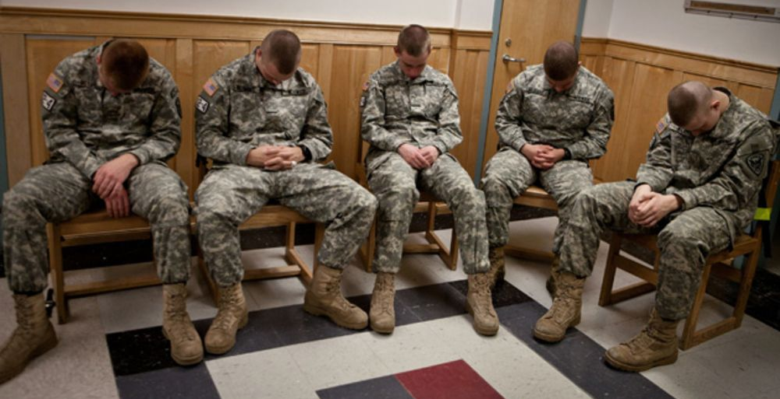
Notes:
Organizations such as Google, Aetna, Mayo Clinic and the United States Marine Corps use mindfulness training to improve workplace functioning and better deal with stress.

Slide 12
Let’s Try it!
HEADSPACE
Notes:
Invitation for this 3 minute mindful activity… not a demand. I am going to play an app I use that has various sessions for various purposes. This one is a “taking a break” session.
Take a moment to get comfortable, putting things down for a moment, sitting up in the chair not slouching but not stiff, feet on the floor, hands on the legs.

Slide 13
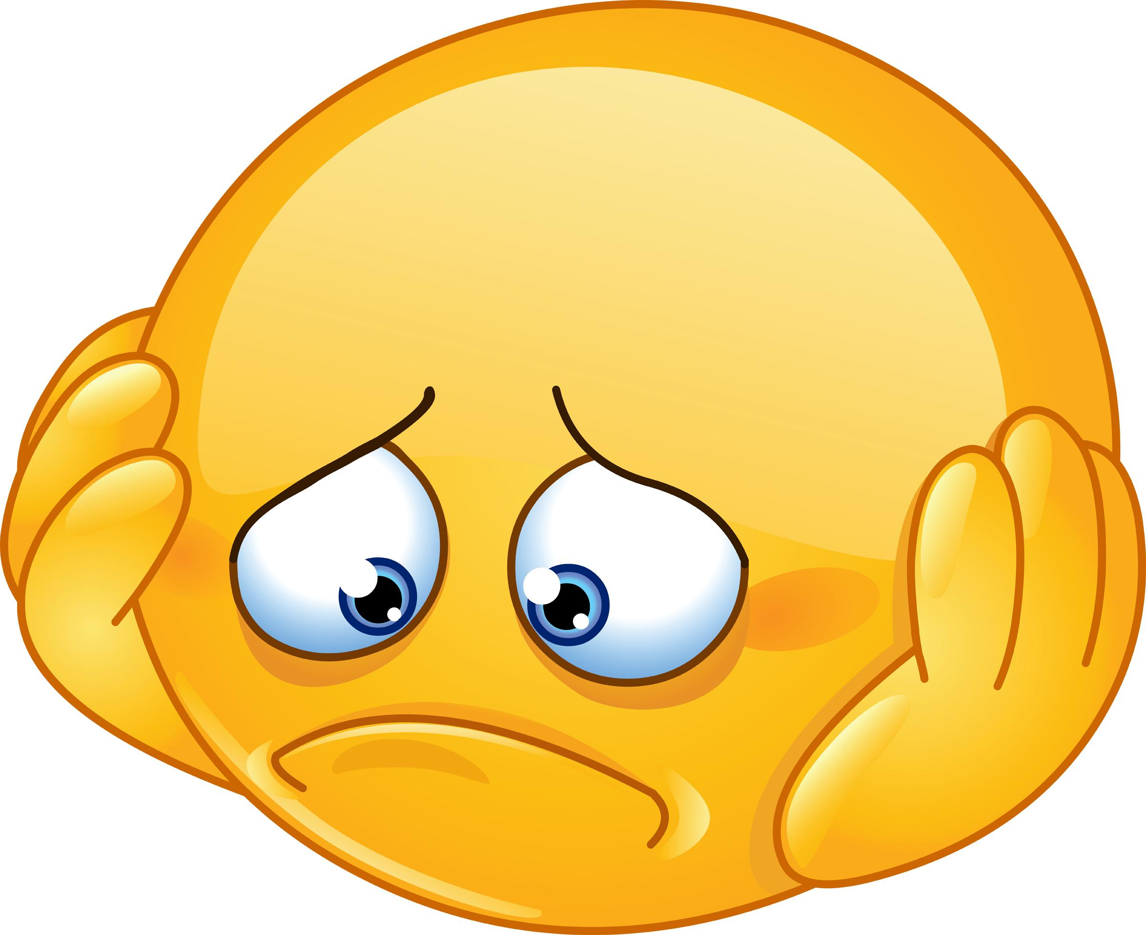
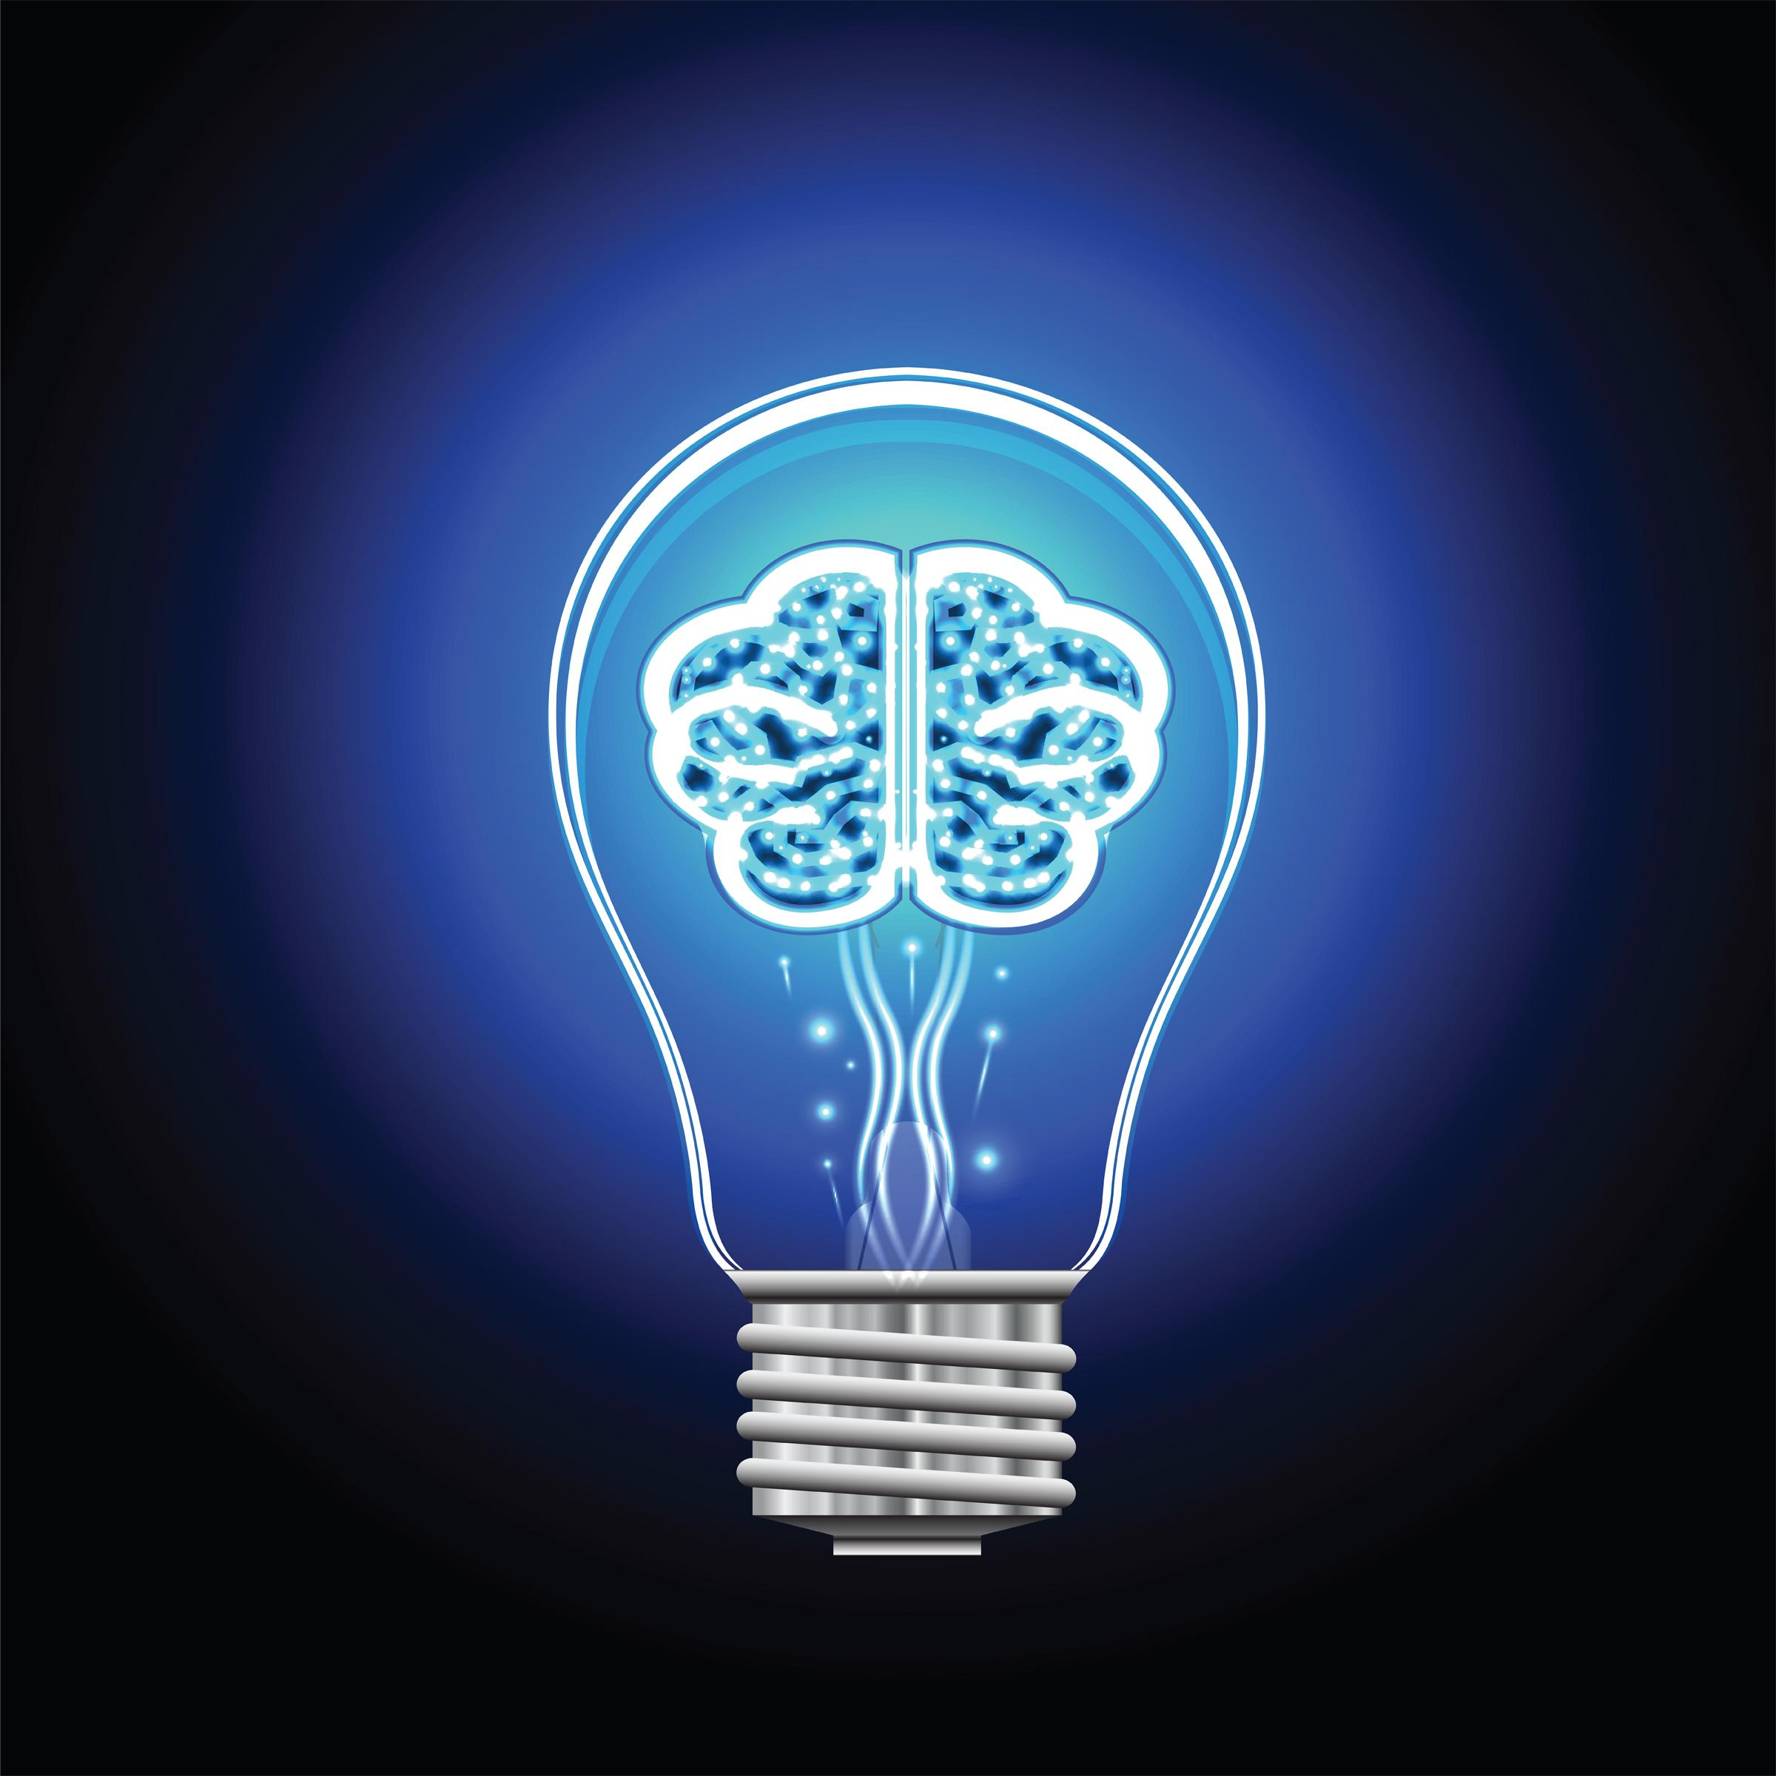
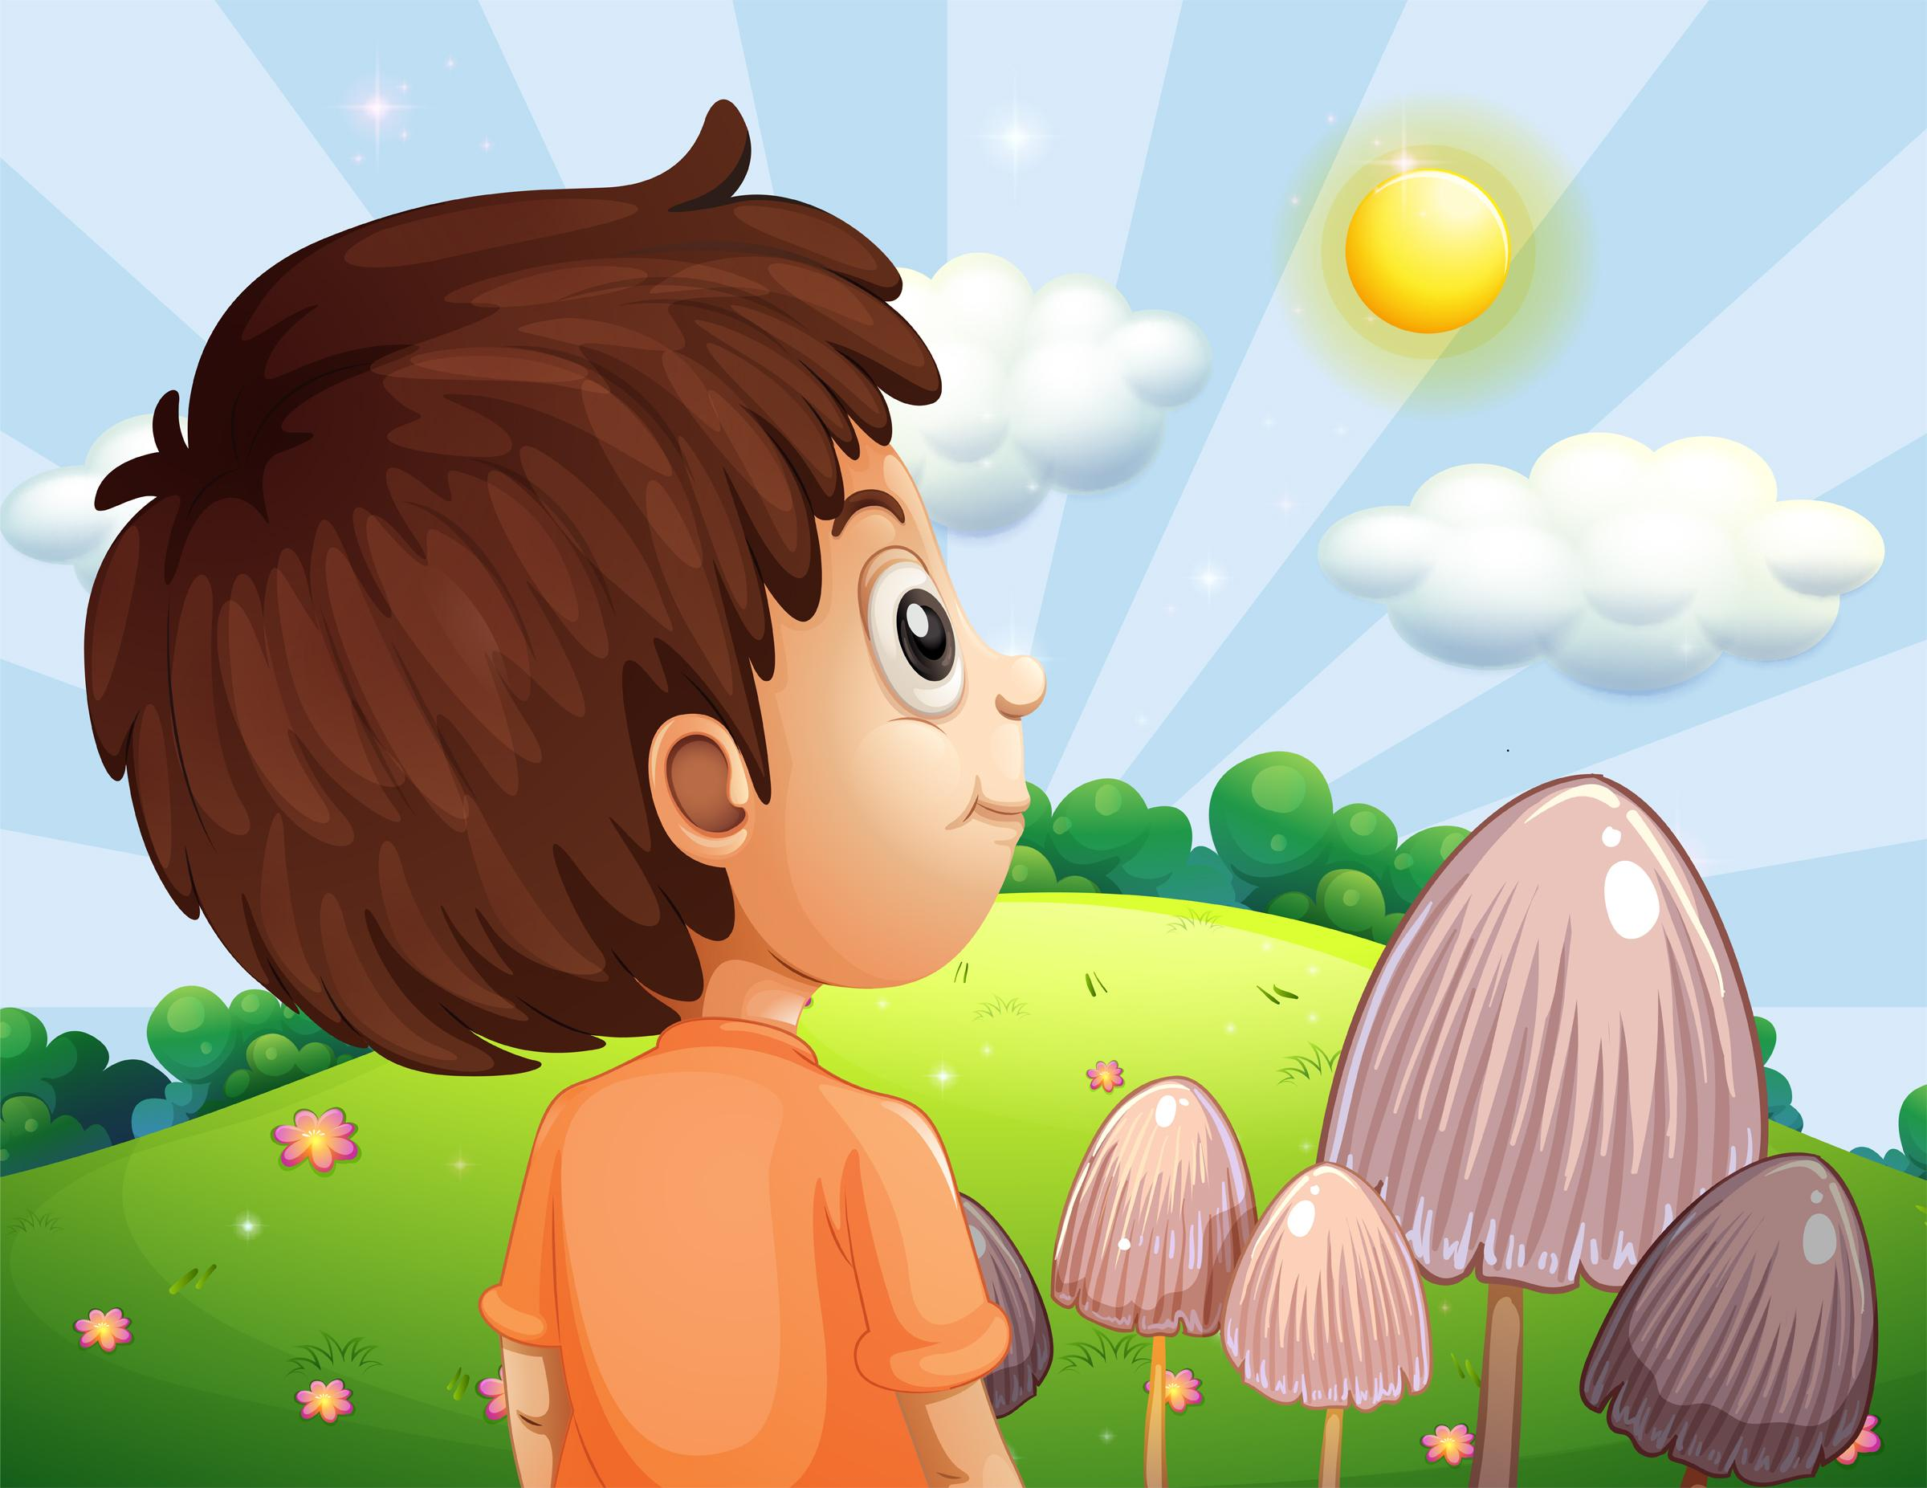
Sorrows
Joy
Notes:
When I took a mindfulness class what stuck with me most is that life is full of difficulties and if I think about how bad it is or look for someone to blame, my suffering multiplies.
And likewise with the pleasant things. I can choose to be caught up in the daily grind and miss the beauty around me or I can be in the moment and truly see that sunrise or my child’s smile and I will feel happiness more times throughout the day.

Slide 14
Personal Practices
Mindfulness Based Stress Reduction
Yoga, Tai Chi, or Qigong class
App on your computer or phone:
Mindfulness bell
Calm
Headspace
Notes:
Ways to bring mindfulness into our individual work and home lives.

Slide 15
Team Practices
Mindfulness Moments to open staff or board meetings
Create an environment that encourages including mindful moments throughout the day
Have a wellness room or corner to take a real break from the action
Notes:
Begin every board meeting with a mindful moment – just a minute or two to help us get grounded and be present for the 2 hours we are together.
Staff meetings include longer periods of guided or unguided mindfulness exercises.

Slide 16
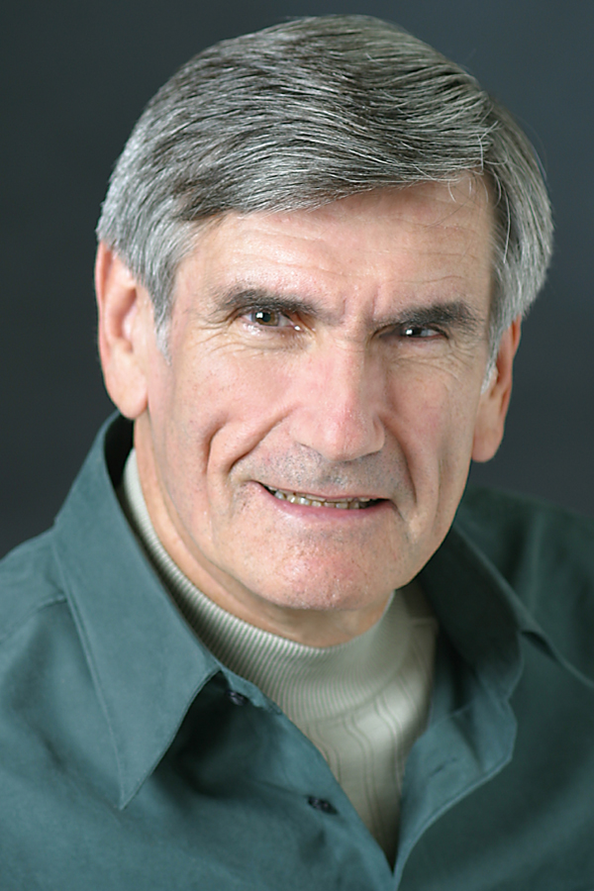
Nonviolent/Compassionate Communication
Marshall Rosenberg
Notes:
A way to carry that compassion into our relationships is something called Nonviolent or compassionate communication. Another tool that that has had a profound effect on how I live my life. Developed by Marshall Rosenberg after studying why some people seem more inclined towards violent or demeaning interactions while others are more likely to talk and act in more nurturing and affirming ways.

Slide 17
“Don’t mix up that which is habitual with that which is natural.”
Notes:
Rosenberg proposes that humans actually are wired to connect with others and it is only because of how we have been acculturated by societies that emphasize domination that we tend to judge and blame and become disconnected not only from the needs of others, but from our own needs. And then everything becomes a jumble.

Slide 18
All Human Behavior
is an Attempt
to Get Our Needs Met
Notes:
This is the key understanding of Nonviolent communication. If I act from this simple but profound premise, things are less jumbled up and it can be clearer to know how to live in a way that I better enjoy and I think is better for the people who come in contact with me.

Slide 19
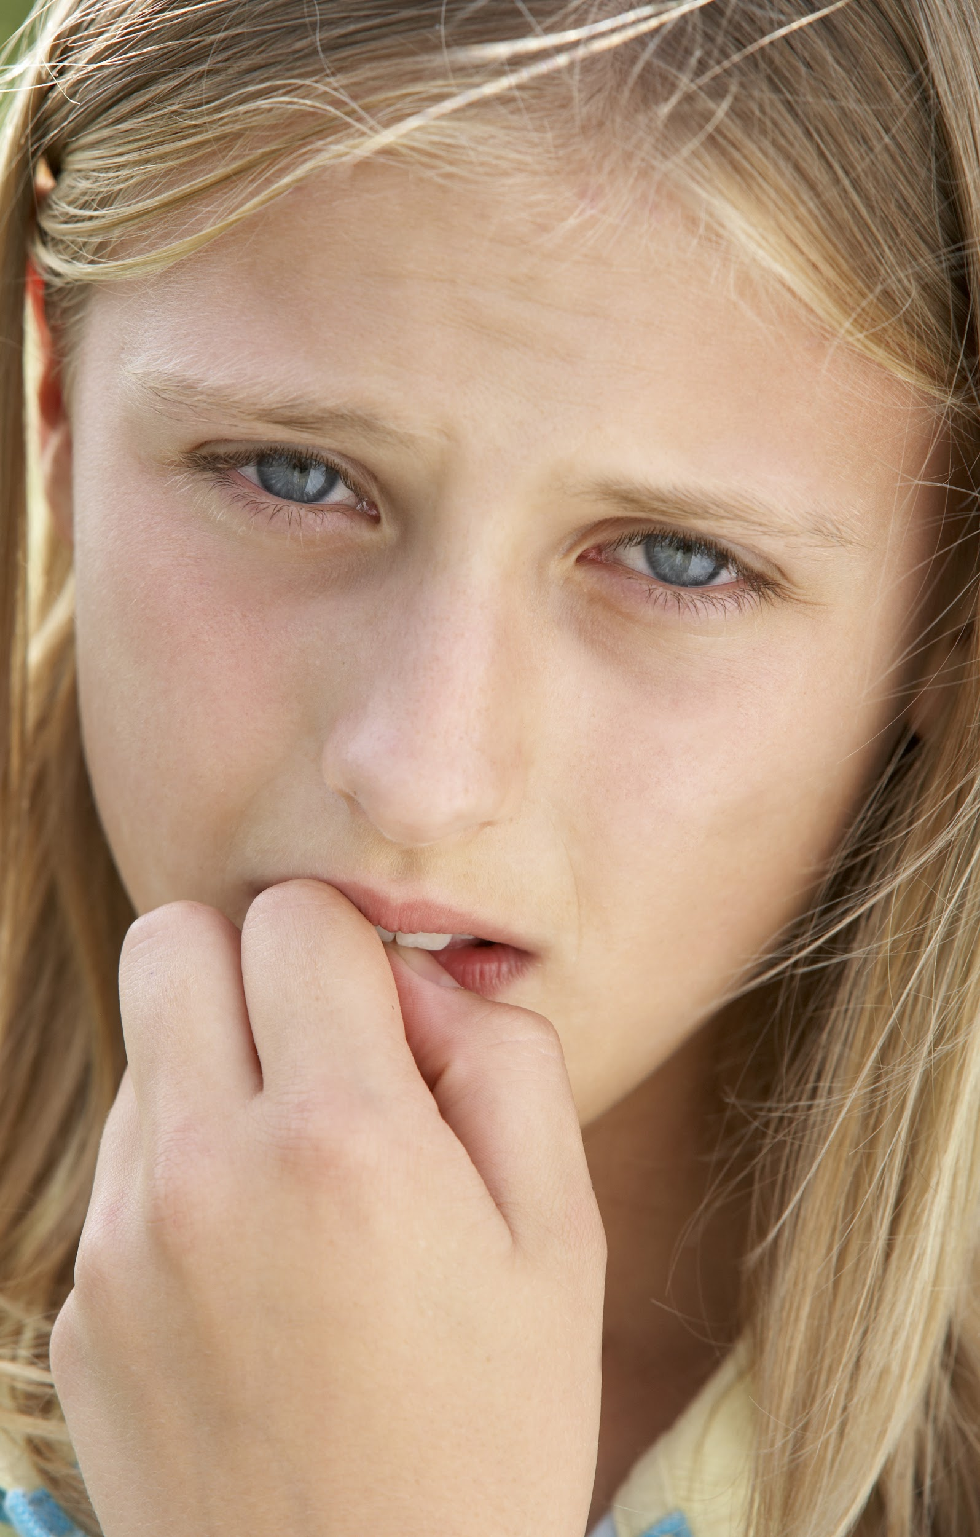
When our needs are not met,
we experience uncomfortable
feelings such as:
Frustration
Sadness
Embarrassment
Notes:
When our needs are not met, we experience uncomfortable or unpleasant feelings such as frustration, sadness, embarrassment

Slide 20
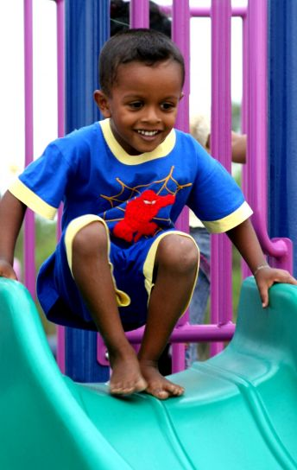
When our needs are met,
we experience comfortable
feelings such as:
Happiness
Calm
Excitement
Notes:
When our needs are met, we experience comfortable or pleasant feelings such as happiness, calm and excitement

Slide 21
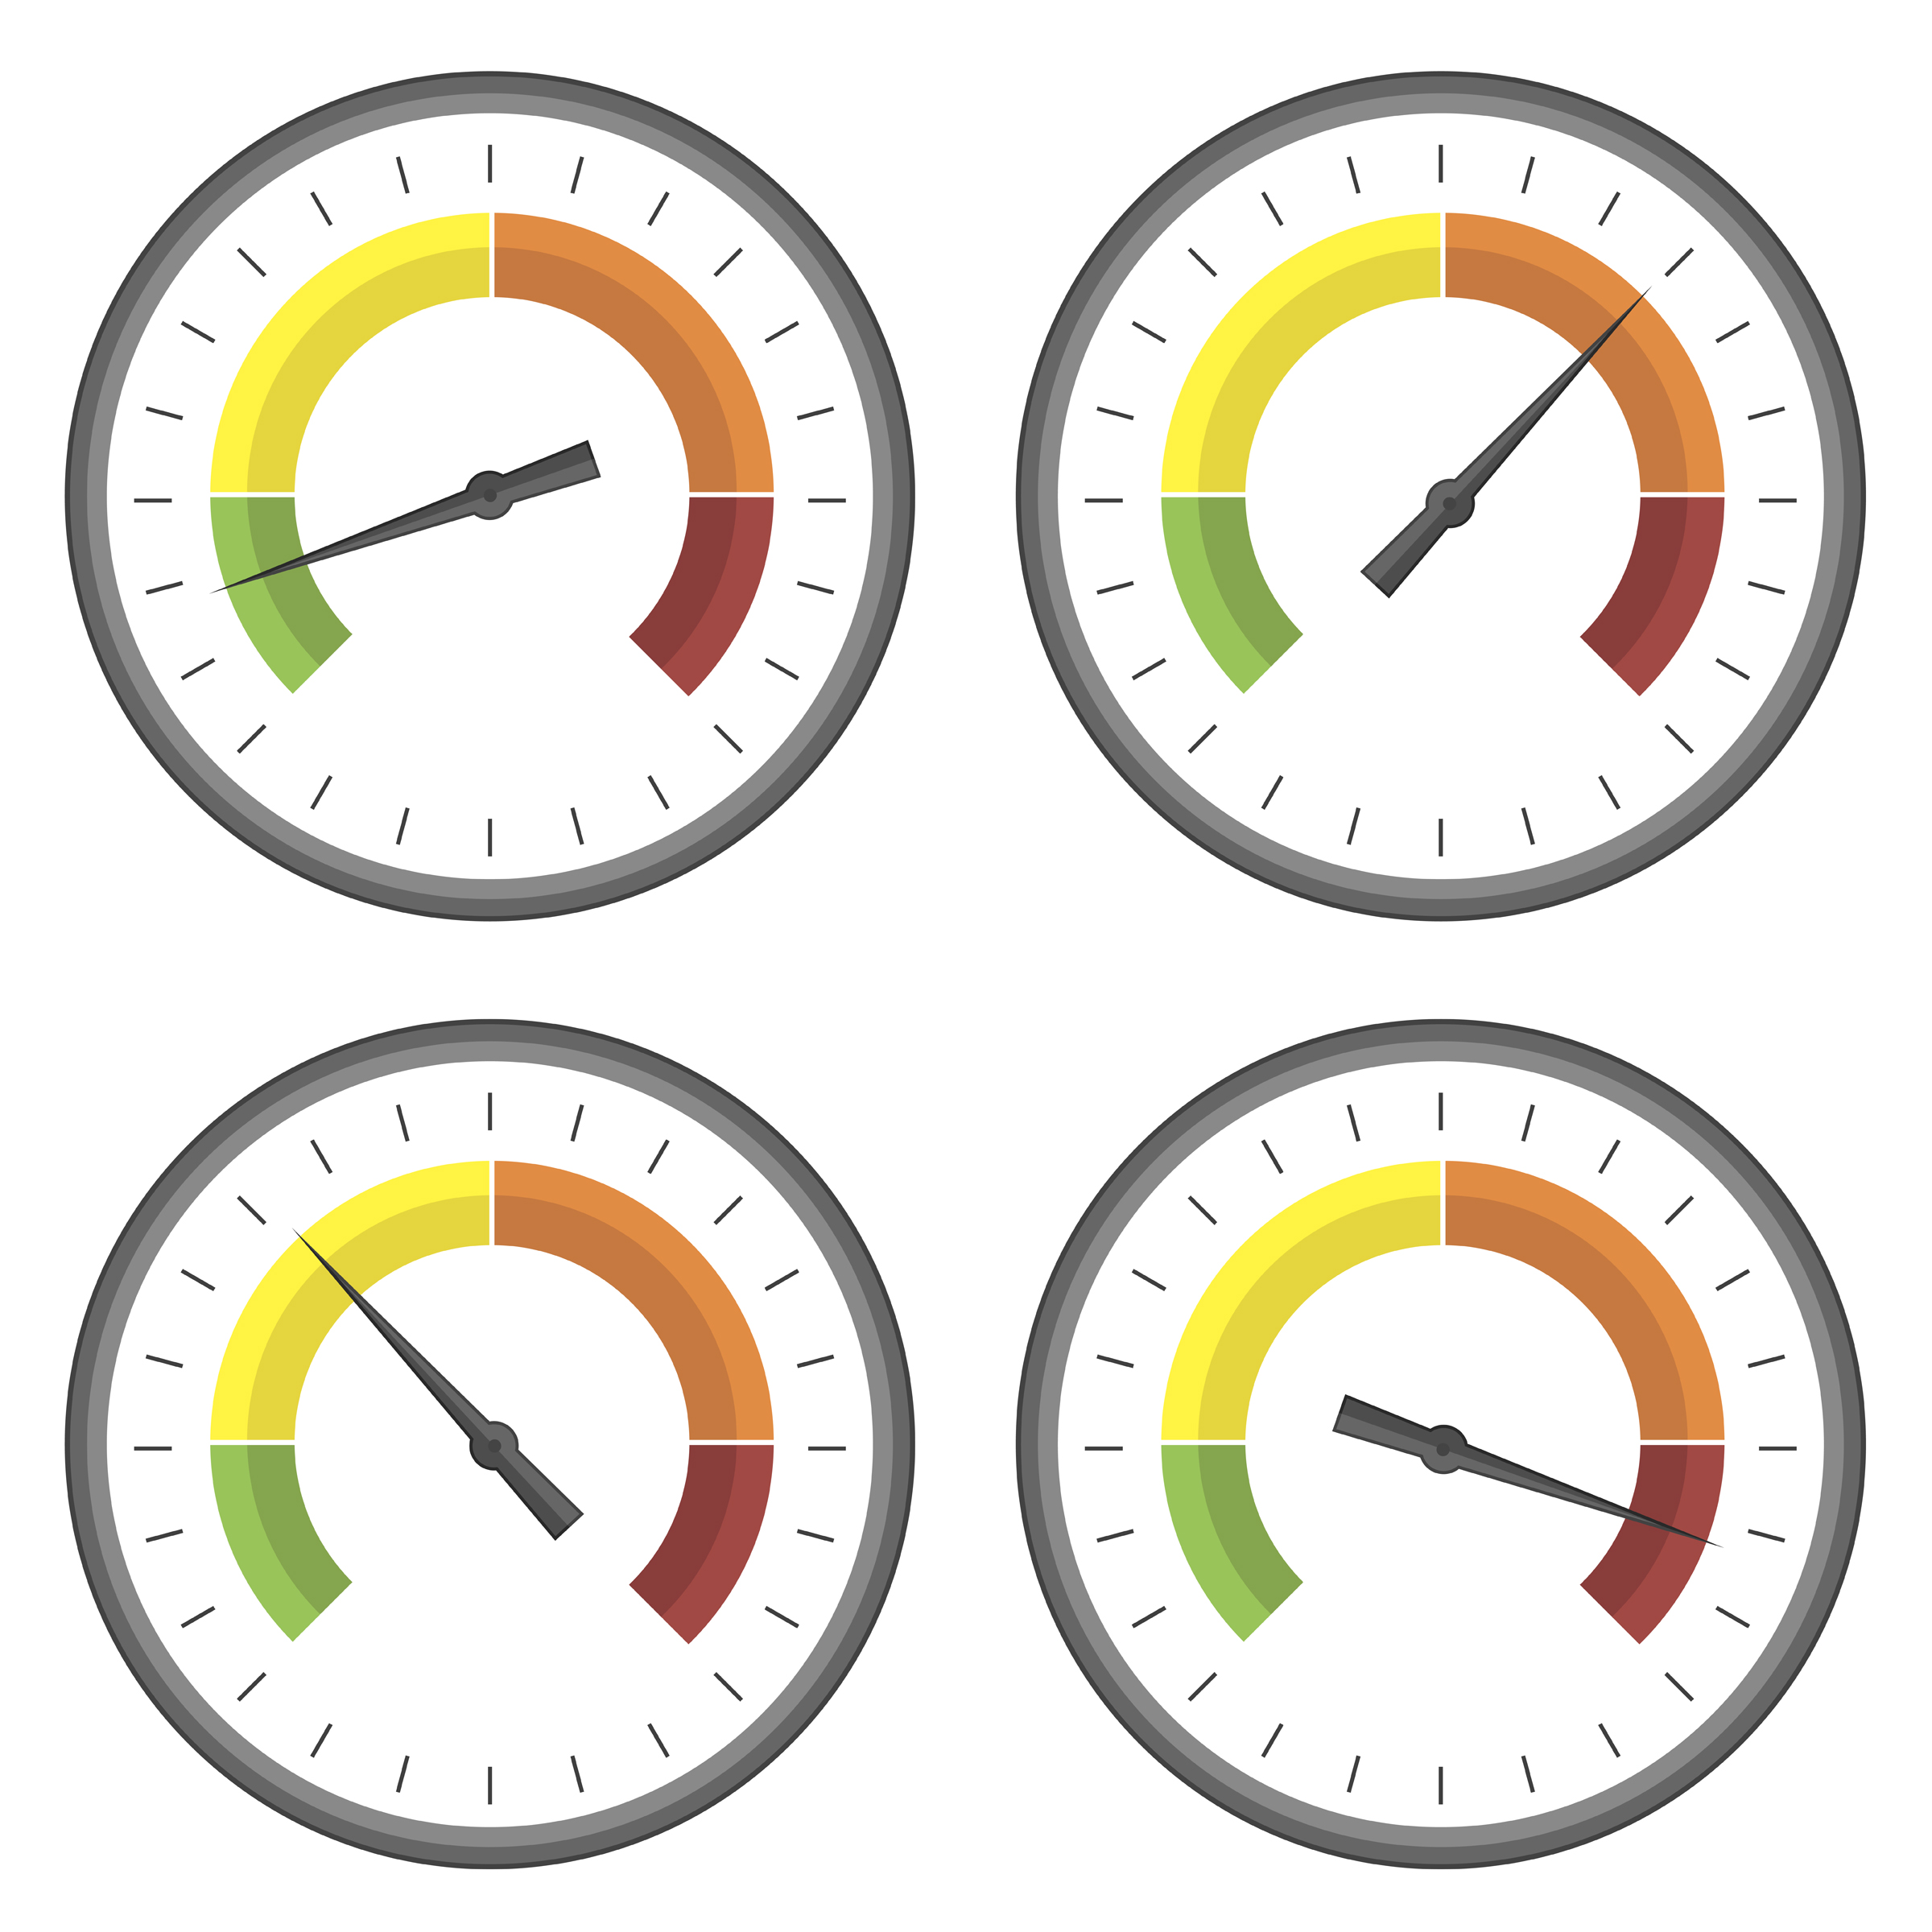
Feelings help us gauge our needs
Notes:
If we are feeling an unpleasant feeling it is like the warning gauge on a car letting us know that a need is not being met.

Slide 22
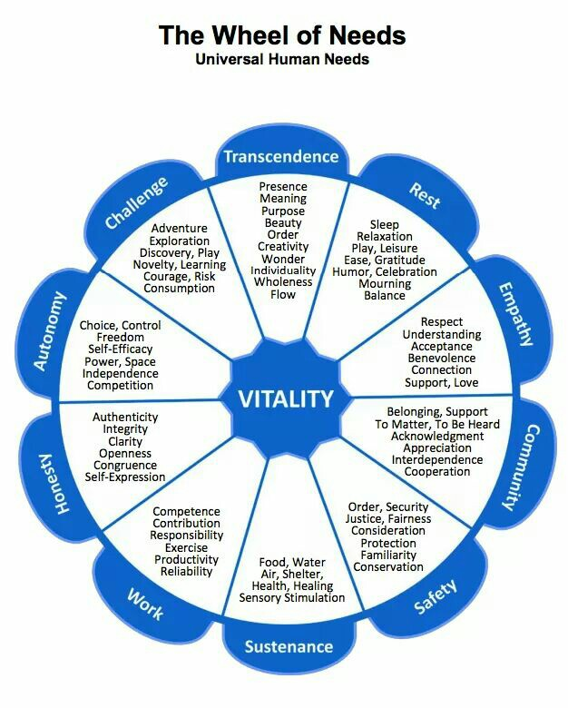
Universal Needs
Notes:
We have many needs as human beings and most of them apply across cultures, socio-economic status, and age ranges.

Slide 23
Let’s Try it!
Needs Activity
Notes:
We are generally not accustomed to identifying our needs. One simple, relatively quick activity that you can use in a staff meeting is using needs cards to help folks connect to their own needs and the needs of their co-workers.

Slide 24
Needs Activity
Divide into groups
Place the “Needs” cards in the center of the circle.
Think of one need that you have right now (it could be met or unmet)
Take turns sharing with the small group your need and 1 or 2 sentences about that if you wish.

Slide 25
Naming
Feelings help us to be happier
Notes:
Research shows that naming your feeling reduces the angry or sad response in the amygdala and activates the prefrontal region, which results in greater happiness. And connecting to our needs has also been demonstrated to improve our immune systems and gain greater life satisfaction.

Slide 26
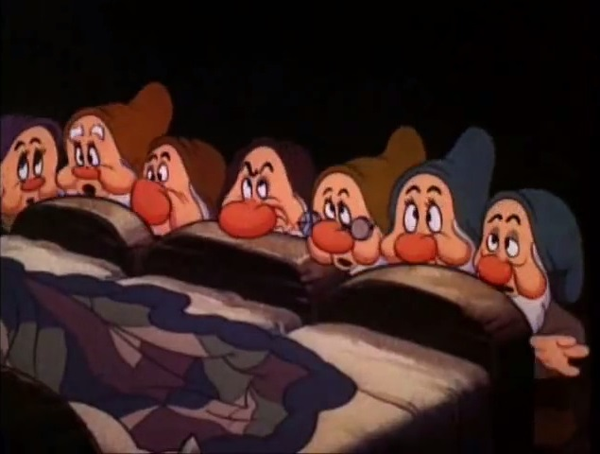
So what if I’m not Happy? I’m just here to do my work!
Notes:
What’s the big deal about happiness?

Slide 27
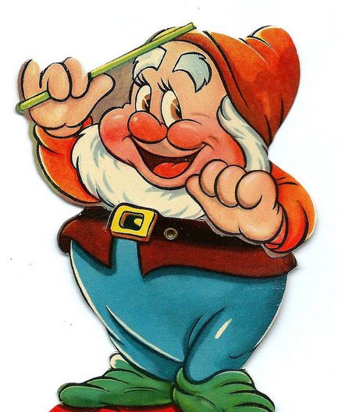
MORE
Flexible
Creative
Helpful
Sociable
Active
Resilient
Notes:
Research has found that when we are happy we are more… flexible, creative, helpful, sociable, active and resilient.
All qualities that I appreciate in my co-workers.
Friedrickson, Advances in Experimental Social Psychology, Vol. 47 published by Elsevier

Slide 28
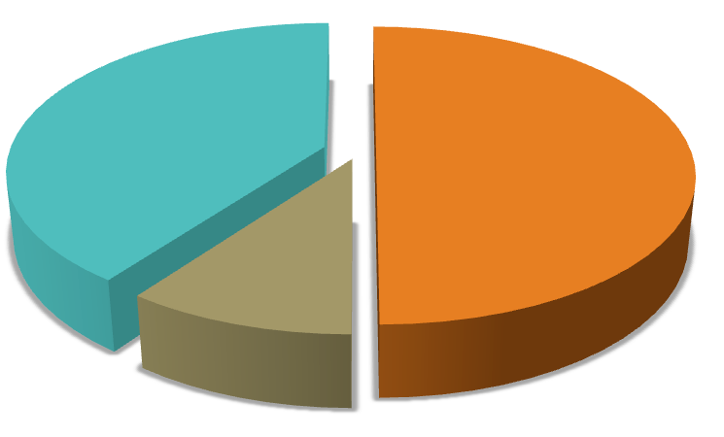
HAPPINESS EQUATION
50% Genetics
40% Intentional
Activities
10% Life Circumstance
Notes:
Research on identical and fraternal twins has shown that we are all born with a baseline happiness, a happiness set point, to which we return after important positive or negative events. It is estimated that this set point accounts for about 50% of differences between people’s levels of happiness.
10% of happiness is accounted for by circumstances.
This leaves us with the portion which is under our control. Through our actions and how we think, we can increase or decrease our level of happiness by up to 40%

Slide 29
Shawn Achor
Notes:
End with a Ted Talk by Shawn Achor because he beautifully and humorously illustrates these concepts.

Slide 30
Resources
Mindfulness
Mindfulness Based Stress Reduction -- MBSR
On line: Sounds True
In Bemidji: Trainer Geri Wilimek, MSW
Apps
Calm
Head Space
Stop, breathe, think
Retreat Centers
Still Quiet Place (30 miles north of Bemidji)
Nonviolent/Compassionate Communication
The Center for Nonviolent Communication
Marshall Rosenberg on the beginnings of NVC
Language of Life: NVC by Marshall Rosenberg
Gratitude/Happiness
Greater Good Science Center
Grategory Game Cards

Slide 31
Find this Presentation
www.peacemakerresources.org
Links
Workplace

Slide 32
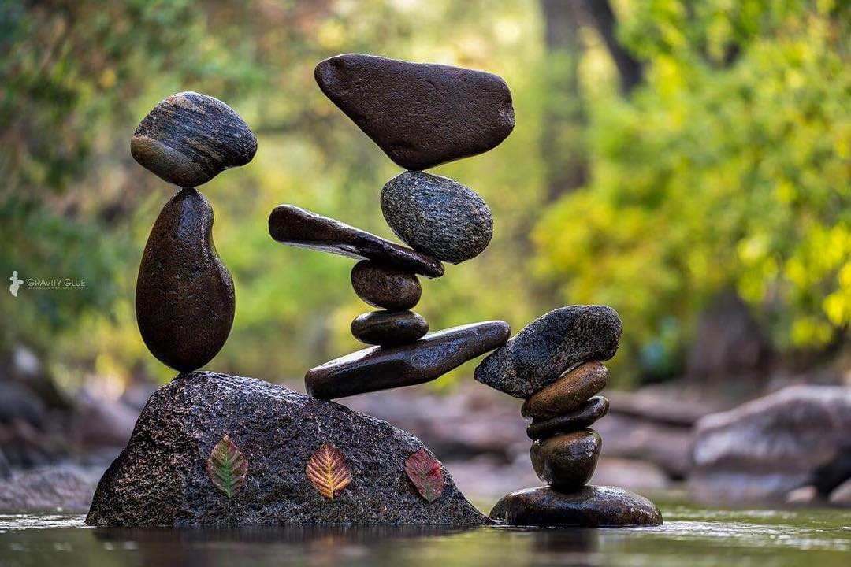
Thank you!!

